Slide 1
lasso regression
Overview
Main ideas behind Lasso regression
How it works
Situations where Lasso regression works
Machine learning

Slide 2
What is LASSO regression?
The lasso regression model was developed in 1989
LASSO regression is similar to RIDGE regression but there is a difference
Lasso stands for least absolute shrinkage and selection operator is a penalized regression analysis method that performs
variable selection
shrinkage.
Suppose we have many features and we want to know which are the most useful features in predicting target in that case lasso can help us.
Features that are not helping in decision making lasso will set their coefficients value very low potentially zero.

Slide 3
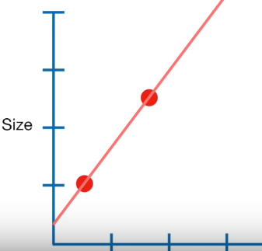

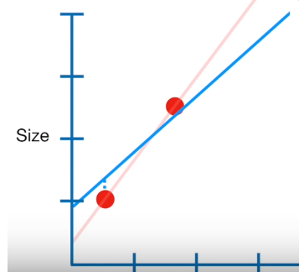
How LASSO regression works
When Lease Squares determines values for the parameters in the linear equation …
size = y-intercept + slope * weight
.. It minimizes The sum of the squared residuals
In contrast when LASSO Regression determines values for the parameters in the linear equation …
size = y-intercept + slope * weight
.. It minimizes … The sum of the squared residuals
plus * |slope|
penalty
Severity of penalty

Slide 4
Ridge vs lasso
Ridge Regression
size = y-intercept + slope * weight
.. It minimizes …
The sum of the squared residuals
plus * slope²
LASSO Regression
size = y-intercept + slope * weight
.. It minimizes …
The sum of the squared residuals
plus * |slope|

Slide 5
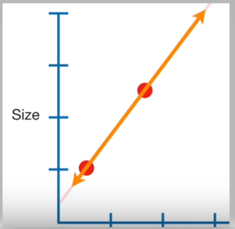
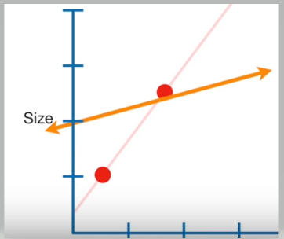
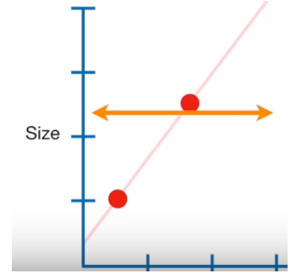
lambda
Lambda = 0, Lasso regression line is same as Least Squares Line
size = y-intercept + slope * weight
The sum of the squared residuals
plus * |slope|
As lambda increases in value, the slope gets smaller.
.. Keep increasing the lambda, the slope becomes ZERO

Slide 6
Big difference between ridge and lasso regression
The big difference between Ridge and Lasso Regression is that Ridge Regression can only shrink the slope asymptotically close to ZERO
while
Lasso Regression can shrink the slope all the way to ZERO
Summary
Lasso regression can exclude useless variables from equation
Ridge regression tends to do better when all variables are useful

Slide 7
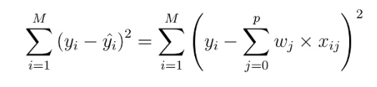
Explaining it bit further
Linear model with n features for output prediction
Considering only a single feature as you probably already have understood that w[0] will be slope and b will represent intercept. Linear regression looks for optimizing w and b such that it minimizes the cost function. The cost function can be written as

Slide 8
Explaining it bit further
Once we use linear regression on a data-set divided in to training and test set, calculating the scores on training and test set can give us a rough idea about whether the model is suffering from over-fitting or under-fitting.
The chosen linear model can be just right also!
If we have very few features on a data-set and the score is poor for both training and test set then it’s a problem of under-fitting.
On the other hand if we have large number of features and test score is relatively poor than the training score then it’s the problem of over-generalization or over-fitting

Slide 9
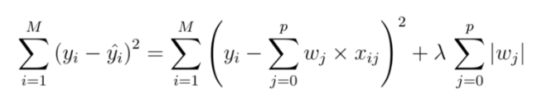

Explaining it bit further
Cost function for Lasso regression
Lasso regression coefficients; subject to similar constrain as Ridge
This type of regularization (L1) can lead to zero coefficients i.e. some of the features are completely neglected for the evaluation of output.
So Lasso regression not only helps in reducing over-fitting but it can help us in feature selection.

Slide 10
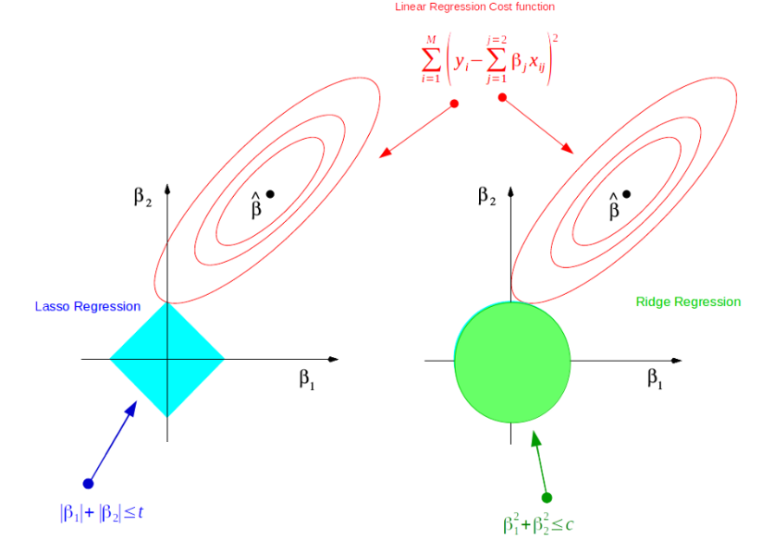
geometric interpretation
The lasso performs L1 shrinkage, so that there are "corners'' in the constraint, which in two dimensions corresponds to a diamond.
If the sum of squares "hits'' one of these corners, then the coefficient corresponding to the axis is shrunk to zero.

Slide 11
Scikit learn
sklearn.linear_model.Lasso(alpha=1.0, fit_intercept=True, normalize=False, precompute=False, copy_X=True, max_iter=1000, tol=0.0001, warm_start=False, positive=False, random_state=None, selection=’cyclic’)[source]¶
alpha : float, optional
Constant that multiplies the L1 term.
Defaults to 1.0.
alpha = 0 is equivalent to an ordinary least square, solved by the LinearRegression object. For numerical reasons, using alpha = 0 with the Lasso object is not advised.

Slide 12
Scikit learn
sklearn.linear_model.Lasso(alpha=1.0, fit_intercept=True, normalize=False, precompute=False, copy_X=True, max_iter=1000, tol=0.0001, warm_start=False, positive=False, random_state=None, selection=’cyclic’)[source]¶
normalize : boolean, optional, default False
If True, the regressors X will be normalized before regression by subtracting the mean and dividing by the l2-norm.
If you wish to standardize, please use sklearn.preprocessing.StandardScaler before calling fit on an estimator with normalize=False.

Slide 13
Scikit learn - attributes
alpha_ : float → The amount of penalization chosen by cross validation
coef_ : array, shape (n_features,) | (n_targets, n_features) → parameter vector (w in the cost function formula)
intercept_ : float | array, shape (n_targets,) → independent term in decision function
mse_path_ : array, shape (n_alphas, n_folds) → mean square error for the test set on each fold, varying alpha
alphas_ : numpy array, shape (n_alphas,) → The grid of alphas used for fitting
n_iter_ : int → number of iterations run by the coordinate descent solver to reach the specified tolerance for the optimal alpha.

